Slide 1
Thread Factory
By Victor

Slide 2
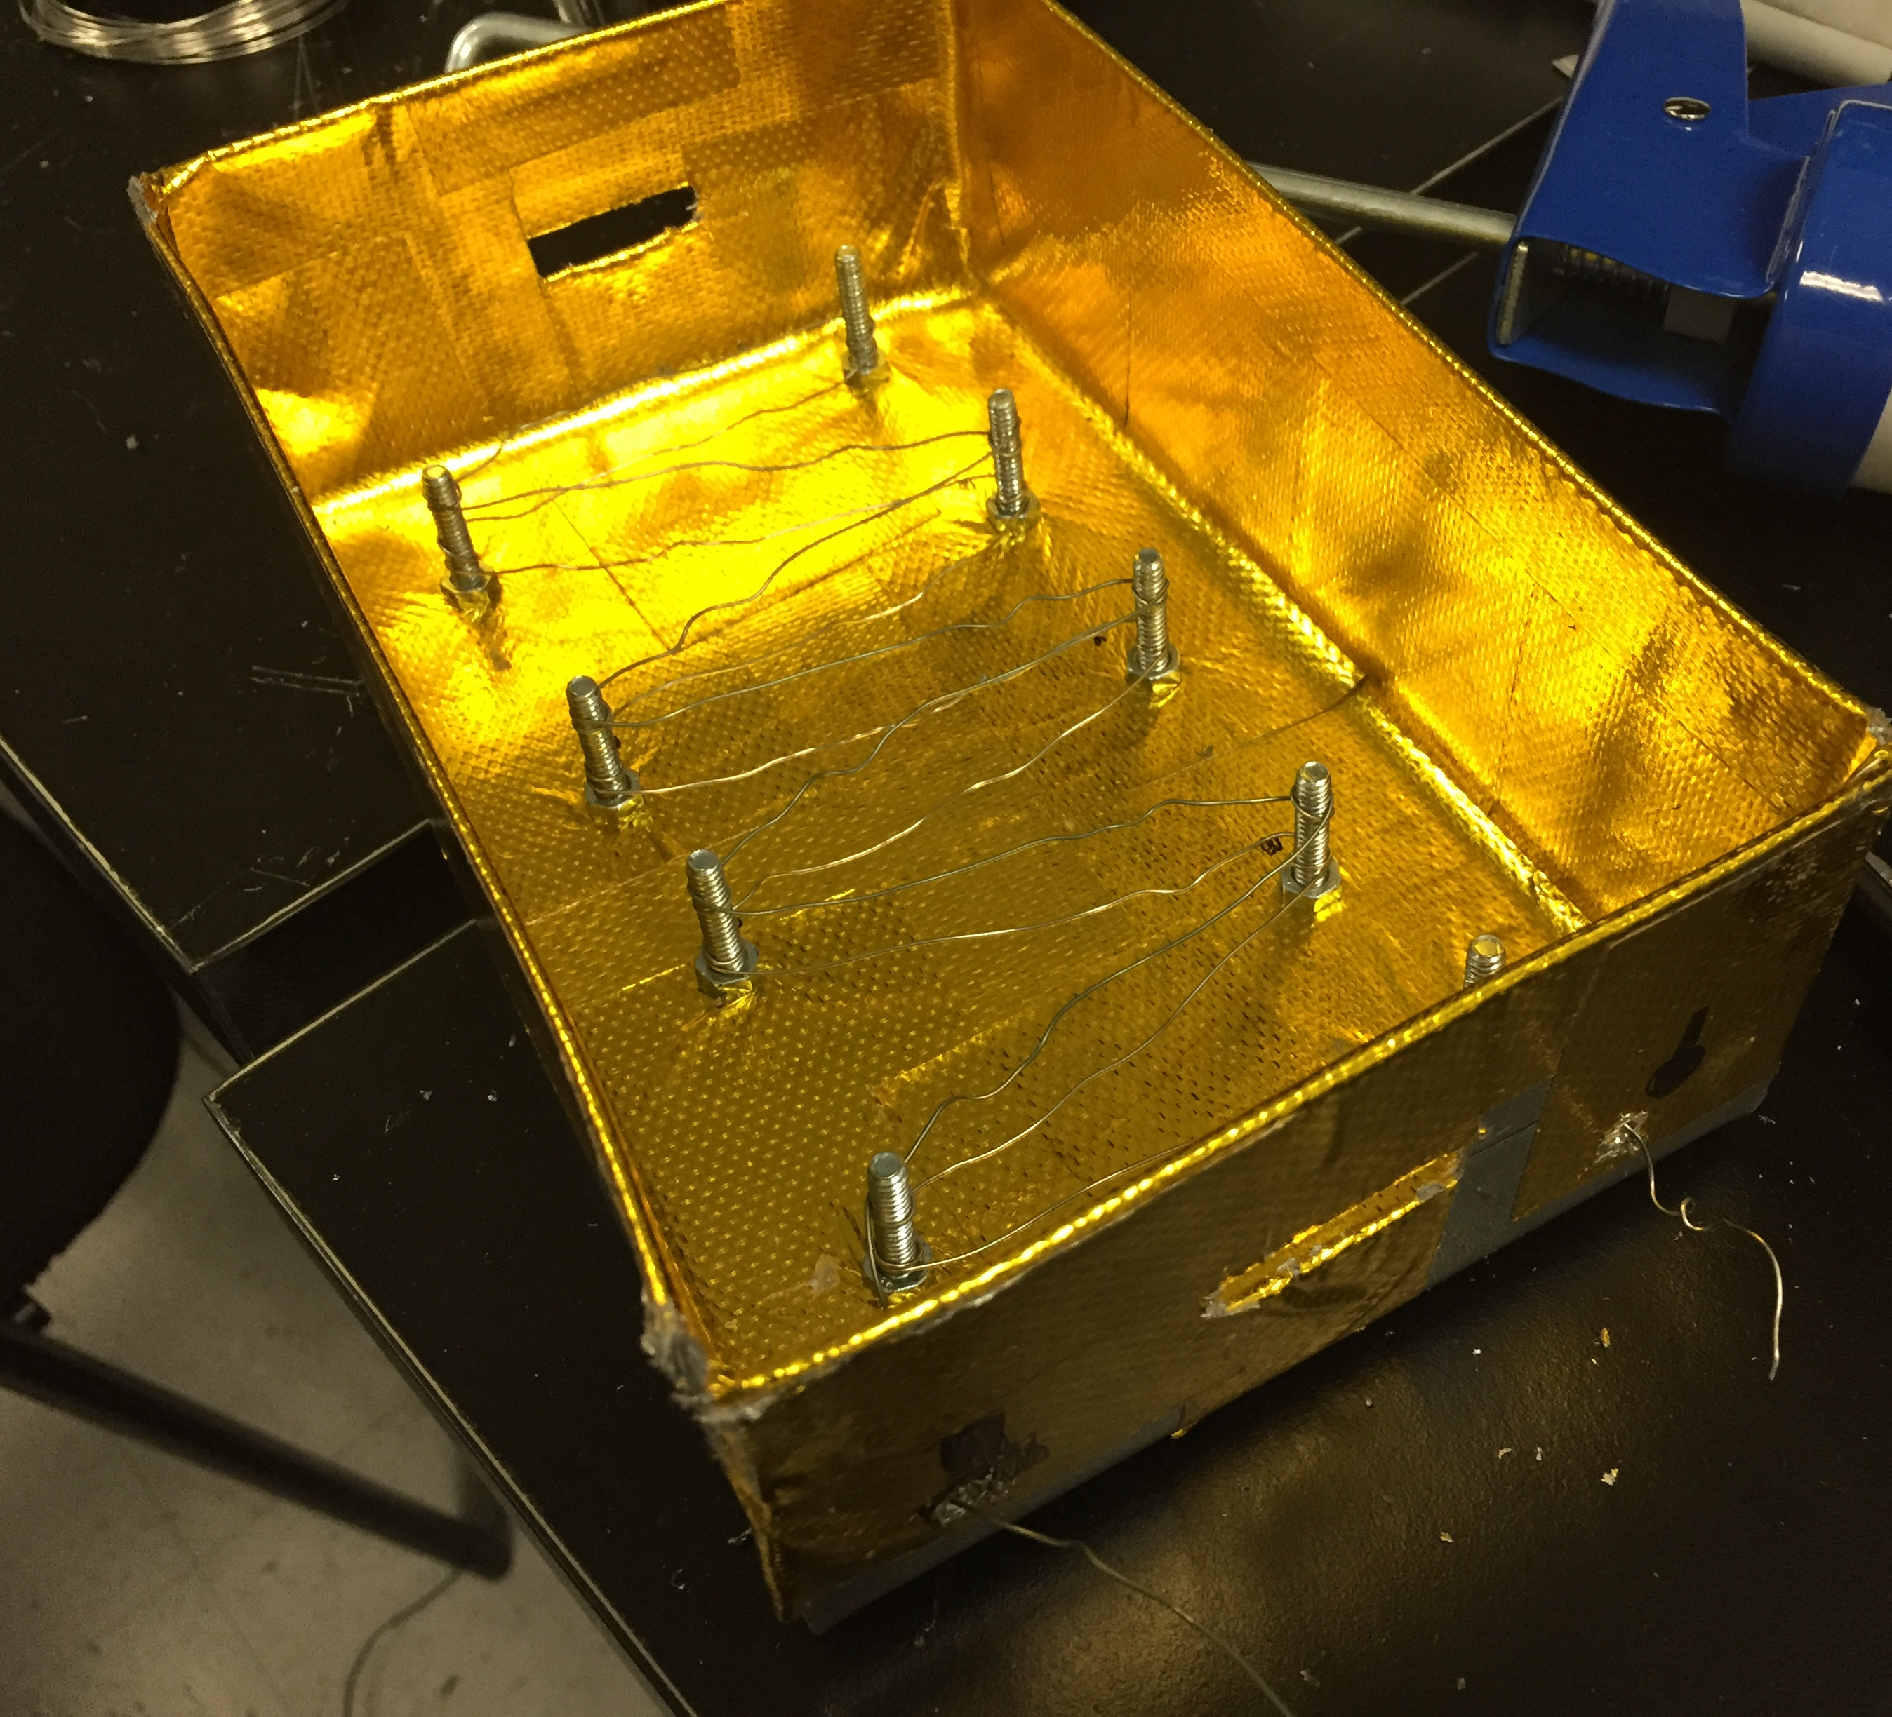
Added nichrome wires to the bottom
Total resistance is 6Ω. With a 24V power supply, amperage is 4A
Ran the current for 10 minutes, barely heated up (wires didn’t even turn red)
When running 24 volts across half of the wire (3Ω with 8A), takes about 1 minute for the wires to turn red
8A seems to be a good current to run through the wire
May consider buying a higher voltage power supply to provide 8A
Currently working on PID controller code

